Slide 1
SPEED DETECTION OF VEHICLES USING YOLOV4 (vehicle registration plate detection)
GROUP – 10
Harini – CB.SC.U4AIE24010
Yogeshwar - CB.SC.U4AIE24011
Pratheep – CB.SC.U4AIE24021
Bhavesh - CB.SC.U4AIE24034

Slide 2
INTRODUCTION:
Vehicle speed detection is very important in traffic management, policing, and highway safety.
As deep learning and computer vision technology have evolved, AI-based solutions provide a cost-efficient and scalable method for speeding detection.

Slide 3
OBJECTIVES:
1.Detection of vehicles in real time
2.Detection of vehicle registration plate
3.Detection of speed of the vehicles

Slide 4
DATA SET DESCRIPTION:
Used a pretrained model for detection of vehicles
Training Dataset(Vehicle Registration plate)
For vehicle registration plate detection taken about 940 images from the google data set.
The labels or annotation files were also downloaded convert into YOLO format for training
The labels we get are in form of classname,xmin,xmax,ymin,ymax are converted into format classid, X-centre, Y-centre, Width, Height and then they are also normalised.
Testing dataset:
In the same about 100 images are taken for training and labels were converted in YOLO-format and predicted their bounding boxes.

Slide 5
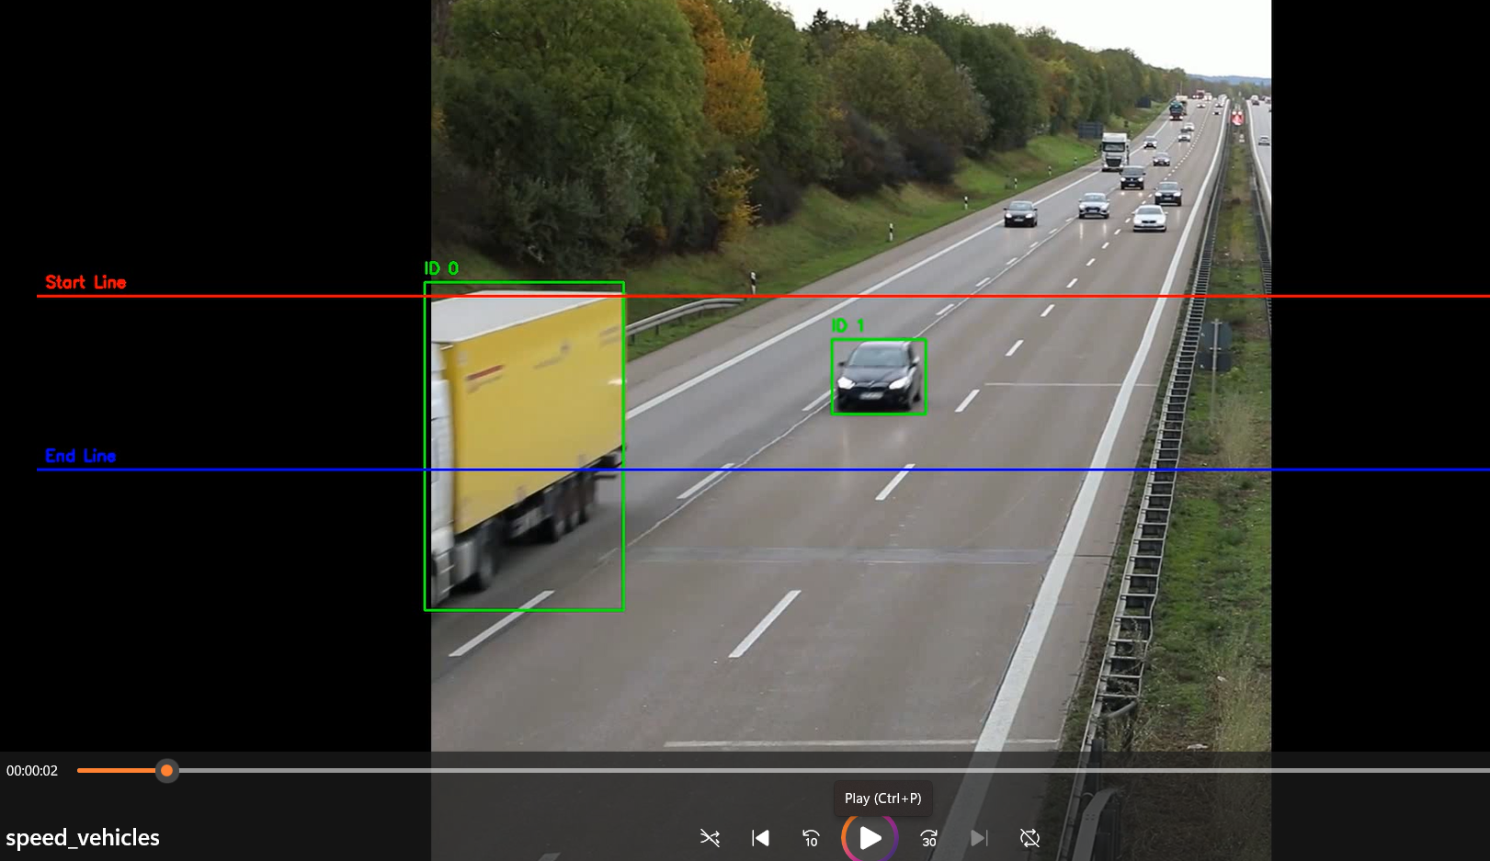
METHODOLOGY:
Detection of vehicles and vehicle registration plate the specified lines and draw boundary boxes
Recording of the time how much time it is in between the lines
CONVERSION OF VIDEO INTO FRAMES
Speed is calculated from the time we got and distance
Used a pretrained YOLO model for detection of vehicles
And trained a YOLOv4 model for detection of vehicle registration plates

Slide 6

Speed calculation:
Two virtual lines are drawn on the video These lines represent a known real-world distance apart
Vehicles are detected using object detection Only relevant vehicle classes (cars, trucks, buses, motorcycles) are considered.
Each vehicle is assigned a unique ID This helps in tracking the same vehicle across multiple frames.
The center point of each vehicle is calculated This is used to determine when a vehicle crosses the start and end lines.
Entry time is recorded when a vehicle crosses the start line The exact video timestamp (in seconds) is saved for that vehicle.
Exit time is recorded when the same vehicle crosses the end line Again, the timestamp is captured for accurate time calculation.
Time taken to travel between the lines is calculated By subtracting the entry time from the exit time..
Speed is calculated using the basic formula
Calculated speed is associated with the vehicle ID This ensures the right speed is shown for the right vehicle.

Slide 7
TRAINING YOLOv4 for Detection of Vehicle Registration plate:
For training we used darknet53 for training the model using YOLOv4
Darknet53 is opensource which contains all framework of YOLOv4 which is written in C and CUDA(Compute Unified Device Architecture.)
Darknet53 contains all the source codes to train and test YOLOv4 models.
Collect all the images and their annotations required for training.
We define architecture of YOLOv4 in configuration file which contains information about activation functions, image resizing, learning rate and so on..
We have given a batch size of 32 and subdivision of 16
After every 1000 iterations we get the weights at last we get best weights.
Need to make obj.data which contains path to train images, test images, where the output file paths should be saved and also obj.names (this file contains the name of the class we are training)file.
One iteration means through layers one batch of images are passed and features are extracted from it
After all iterations the best weights get stored which are used for detecting objects in new images.

Slide 8

Model Architecture:
STEP-1- IMAGE PROCESSING :
Image is converted into pixels of dimensions [m,n,3] (RGB Image)
Normalization of pixel values
I/255
For training image is passed as a tensor
Input image=[N H W C]
STEP-2 CONVOLUTION
Convolution is a mathematical operation that combines two functions (or signals) to produce a third function that represents how the shape of one is modified by the other.
Convolution applies features(K) to the input image and extract features, producing a feature map(O)
Filters are optimized via backpropagation by comparing detected features (bounding boxes) with ground truth using gradient descent.

Slide 9

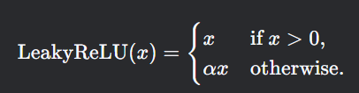

STEP 3: ACTIVATION FUNCTION (ReLU, LeakyReLU,Mishfunction etc.)
Purpose: Introduces non-linearity to the model, enabling complex feature learning.
Effect:
Removes negative activations
STEP 4: POOLING (Dimensionality Reduction)
Purpose: Reduces spatial dimensions (w,h) while retaining important features.
Types: 1. Max Pooling: Takes the maximum value in a window.
2. Average Pooling: Takes the average value in a window.
Effect:
Reduces computation in deeper layers.

Slide 10
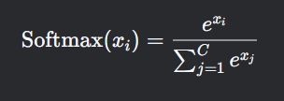

STEP 5: FULLY CONNECTED LAYERS (Classification/Regression Head)
Flattening: Converts the 3D feature map into a 1D vector.
Dense Layers:
Each neuron connects to all activations from the previous layer.
Final layer uses:
Softmax (for classification).
Sigmoid/Linear (for regression, e.g., bounding box coordinates).
The final layer predicts the tx,ty,tw,th (bounding box co-ordinates) and also confidence score and probabilities of each class

Slide 11

STEP-6 Loss function calculation and back propogation
1. Bounding Box Regression Loss:
Purpose: Measures box accuracy (how well predicted boxes match ground truth).
IOU: Intersection-over-Union (measures overlap).
ρ²: Squared distance between box centers.
c: Diagonal length of smallest enclosing box.
α, v: Penalty terms for aspect ratio mismatch.

Slide 12

2.Confidence Loss :
Purpose : Predicts if a box contains an object
Formula:
C = Predicated confidence (sigmoid output)
C = Ground truth ( 1 if object exists, 0 otherwise)

Slide 13

3.Classification Loss :​
Purpose : Measures class predication error​
Formula:
p_C = Predicted class probability (Sigmoid output)
C_p = Grounded truth class label
gamma = Focusing parameter(default: 1.5 in YOLOv4)

Slide 14

Total Loss in YOLOv4:​
Formula:
_coord = Weight for box coordinate
_conf = Weight for objectness
_class = Weight for class predictions

Slide 15

Optimization:​
YOLOv4 uses SGD with Momentum for training:
Formula:

Slide 16
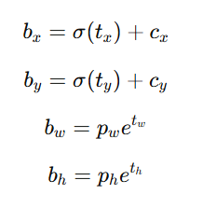
YOLO ALGORITHM FOR DETECTION OF OBJECTS
An imaged is pre-processed in to size and then normalized by dividing by 255
The image is converted in to n x n grid
Each grid cell predicts B bounding boxes using anchor boxes
The image is now passed through the trained convolutional neural network from weights
After the feature detection we are passing the image in to output layers for detection of bounding boxes
Bounding Box Coordinates (x, y, w, h):
(x, y) = Center relative to the grid cell.
(w, h) = Width & height relative to anchor box
Objectness Score (Confidence) → Probability that the box contains an object (0 to 1).
Class Probabilities → Predicts the class of the detected object (using sigmoid/softmax).

Slide 17
Output Tensor Shape: (S × S × [B × (5 + C)]) where:
B = Number of anchor boxes per cell (e.g., 3).
5 = (x, y, w, h, confidence).
C = Number of classes.
Remove boxes with confidence < threshold (e.g., 0.5).
Eliminate duplicate detections of the same object
Sort boxes by confidence.
Select the box with the highest confidence.
Remove all other boxes with high IoU overlap (e.g., IoU > 0.45).
List of detected objects with:
Bounding Boxes (x, y, width, height).
Class Labels (e.g., "car").
Confidence Scores (0 to 1).

Slide 18
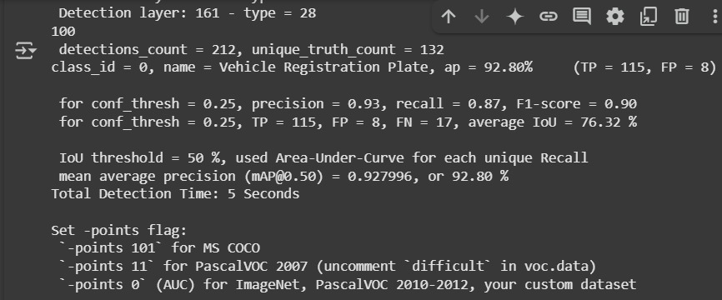
RESULTS:
1.The vehicle registration plate is being detected properly with mAP of 92.8% and the precision ( 93%),F1-score(90%), Recall(87%)

Slide 19
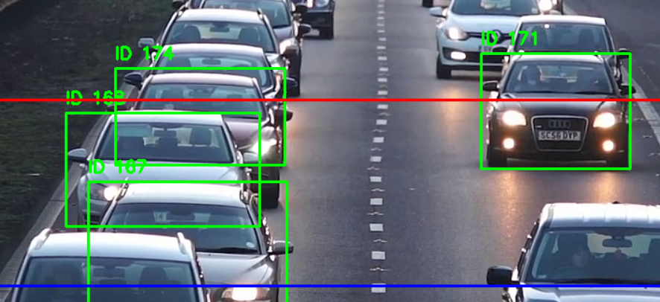
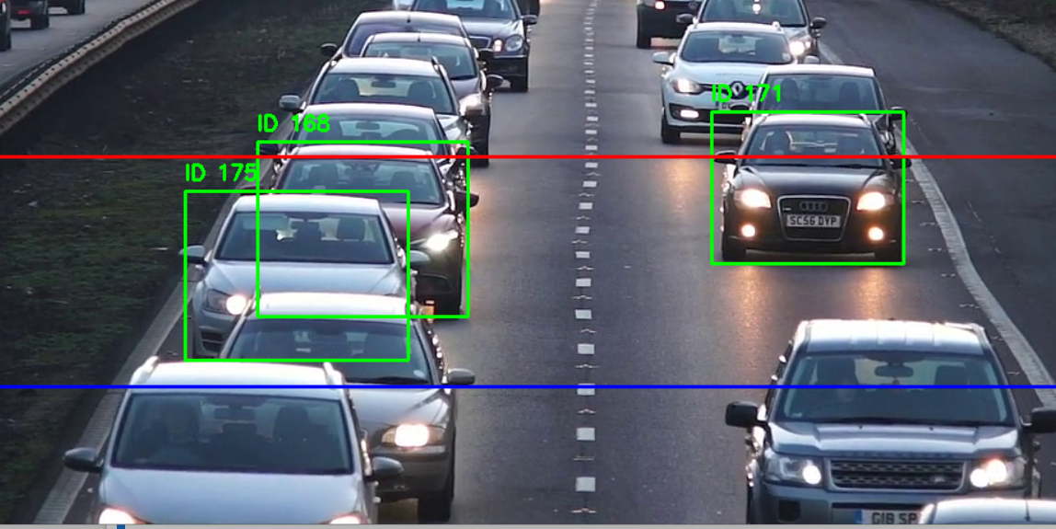
Speed is being detected properly when the car and objects are distant but if the cars are overlapping as shown in figure the new id is being allotted and getting confused

Slide 20
Limitations:
This type of trackers would not properly work in all the cases.
Because here we are tracking the vehicles using centre but in some camera angles the way vehicles appear would overlap on each other which would confuse the model and assign multiple ID’s to the same vehicle .
And for vehicle registration plate detection the camera should not be much far it should be nearer at as we are able to see the vehicle.
We also need high quality videos to detect the vehicles and Vehicle registration plates accurately which would require high quality cameras.
FUTURE IMPLEMENTATIONS:
We can link the number plate detected to the ID of the car and also read the number plate and see if their exceeding speed limits take necessary actions.

Slide 21
THANK YOU

